Slide 1
Graph Structures and Minimum Spanning Trees
Chaklam Silpasuwanchai

Slide 2
Readings
Chapter 22-23, Elementary Graph Algorithms, Minimum Spanning Trees, Cormen et al. (2009). Introduction to Algorithms, Third Edition (3rd ed.). The MIT Press.
Chapter 5, Graph Traversals, Skiena, S. S. (2008). The Algorithm Design Manual, Second Edition (2nd ed.). Springer Science & Business Media.
Chapter 13, Graphs, Robert Lafore. (2002.) Data Structures and Algorithms in Java, Second Edition (2nd ed.). Sams, Indianapolis, IN, USA.
Douglas Wilhelm Harder, Waterloo University - https://ece.uwaterloo.ca/~dwharder/aads/

Slide 3
Outline
Introduction to Graphs
Data Structures for Graphs
Breadth-First Search
Depth First Search
Minimum Spanning Tree
Kruskal’s Algorithm
Prim’s Algorithm

Slide 4
Graphs
Graphs are one of the unifying themes of computer science.
A graph G = (V, E) is defined by a set of vertices V , and a set of edges E consisting of ordered or unordered pairs of vertices from V.
V*(V-1) is maximum number of edges in directed graph. Number of edge in undirected graph is (V * (V-1)) / 2. If in directed graph, self-loop is allowed, the maximum of edges will be V²

Slide 5
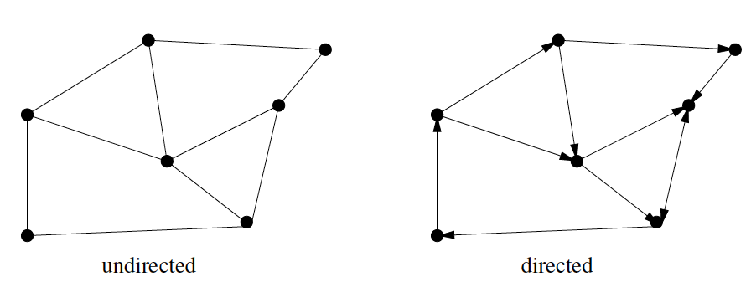
Directed vs. Undirected Graphs
A graph is undirected if (x, y) is same as (y, x)

Slide 6
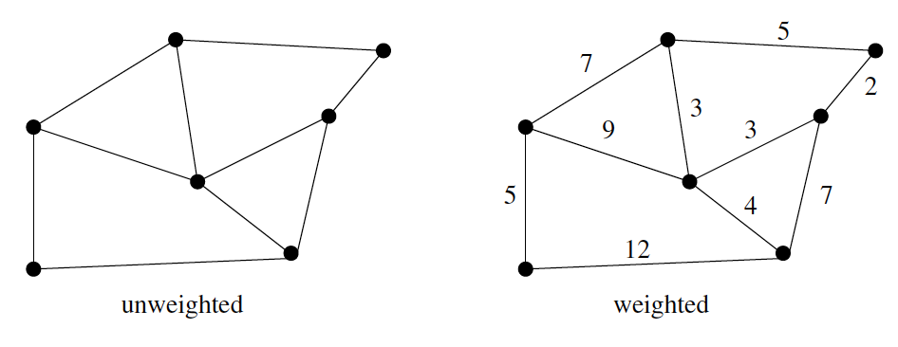
Weighted vs. Unweighted Graphs
In weighted graphs, each edge (or vertex) is assigned a numerical value, or weight

Slide 7
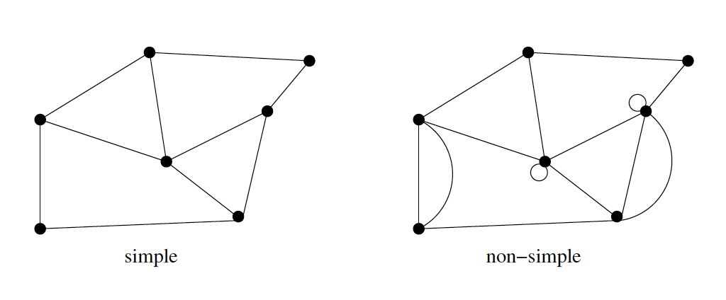
Simple vs. Non-simple Graphs
Self loop -> (x, x)
Multi-edge -> it occurs more than once

Slide 8
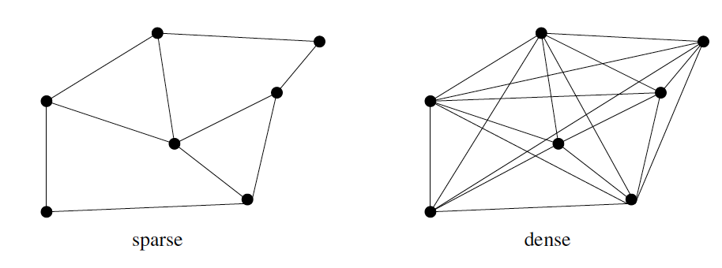
Sparse vs. Dense Graphs
Sparse - few number of vertex pairs (usually linear)

Slide 9
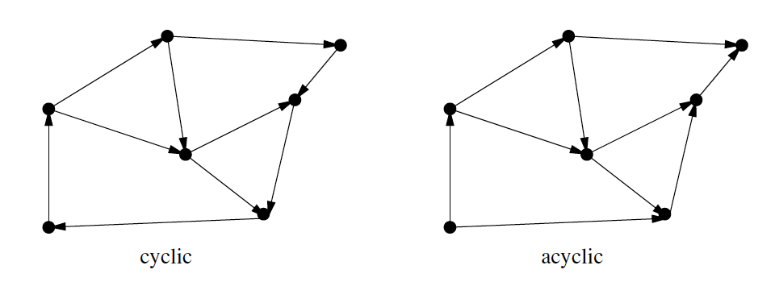
Cyclic vs. Acyclic Graphs
Acyclic - no cycles
Directed acyclic are called DAGs

Slide 10
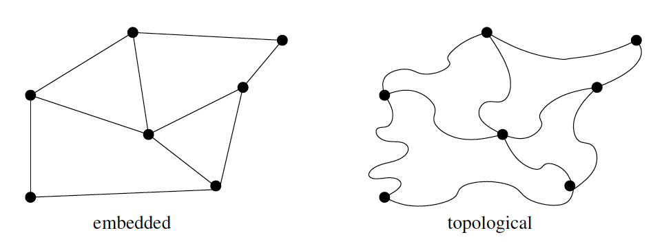
Embedded vs. Topological Graphs
Embedded - assigned geometric positions

Slide 11
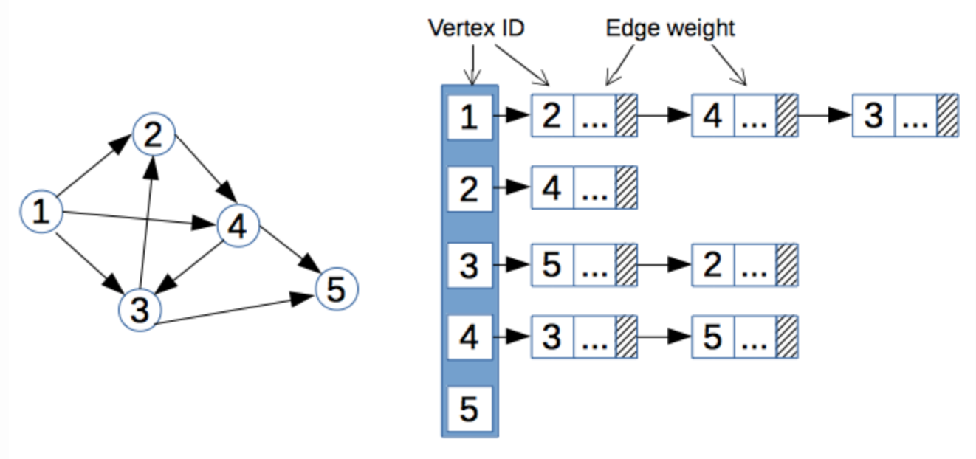
Data Structures for Graphs: Adjacency List

Slide 12
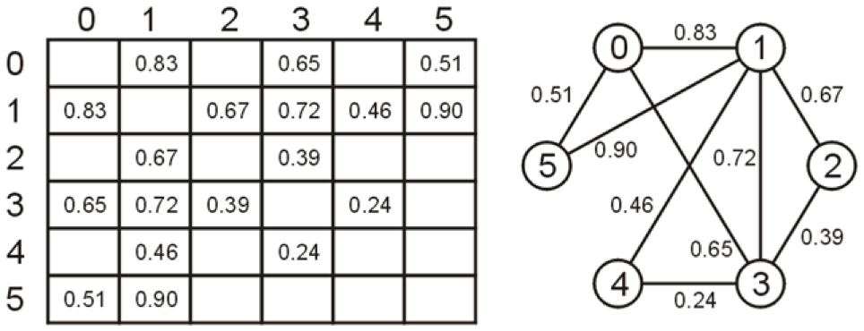
Data Structures for Graphs: Adjacency List

Slide 13
Data Structures for Graphs: Adjacency Matrix

Slide 14
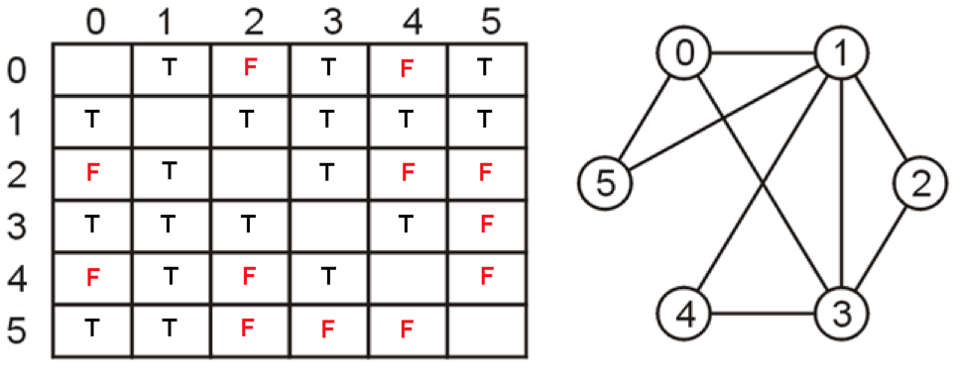
Data Structures for Graphs: Adjacency Matrix

Slide 15
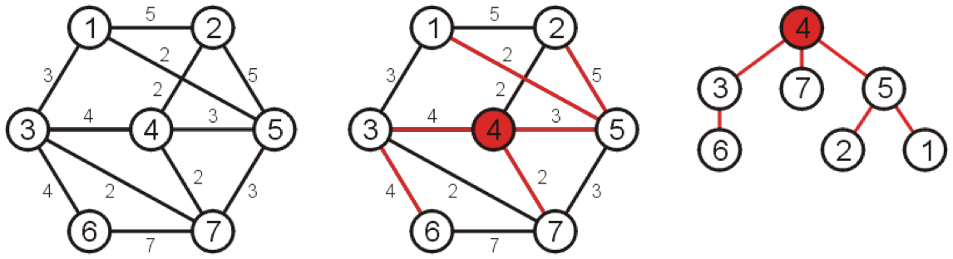
Data Structures for Graphs: Adjacency Matrix

Slide 16
Data Structures for Graphs: Adjacency List
The adjacency-list representation of a graph G = (V, E) consists of an array Adj of |V| lists, one for each vertex in V. For each u ∈ V, the adjacency list Adj[u] contains all the vertices v such that there is an edge (u, v) ∈ E. That is, Adj[u] consists of all the vertices adjacent to u in G.
If G is a directed graph, the sum of the lengths of all the adjacency lists is |E|. If G is an undirected graph, the sum will be 2 |E|.
Adjacency lists use memory in proportion to the number edges, O(V+E), which works well for sparse graphs where |E| is much less than |V|²
It is fast to iterate over all edges, but finding the presence or absence specific edge is slightly slower than with the matrix (takes O(n))
Not so good for unweighted graphs, as each entry takes more than at least two bits

Slide 17
Data Structures for Graphs: Adjacency Matrix
An adjacency matrix uses O(V*V) memory.
Adjacency matrix is preferred for dense graph when |E| is close to |V|²
Adjacency matrix is also preferred for fast lookups to check for presence or absence of a specific edge with complexity of O(1)
However, Adjacency matrix is slow to iterate over all edges to build the matrix

Slide 18
Graph Traversals

Slide 19
Searching
Traversals = searches
Breadth-first or Depth-first search
– Breadth-first - queue;
Bittorrent
Crawlers
Social Network
– Depth-first - stack
best game path

Slide 20
Breadth-first traversal
Given a graph G = (V, E) and a source vertex s, breadth-first search discover all vertices at distance k from s, before discovery any vertices at distance k + 1
Breadth first search colors each vertex white, gray or black. All vertices start out white, and may later become gray and then black.
A vertex becomes non-white when it is discovered the first time
If (u, v) ∈ E and vertex u is black, then vertex v is either gray or black, that is, all vertices adjacent to black has been discovered. Gray vertices may have some adjacent white vertices; they represent the frontier between discovered and undiscovered vertices

Slide 21
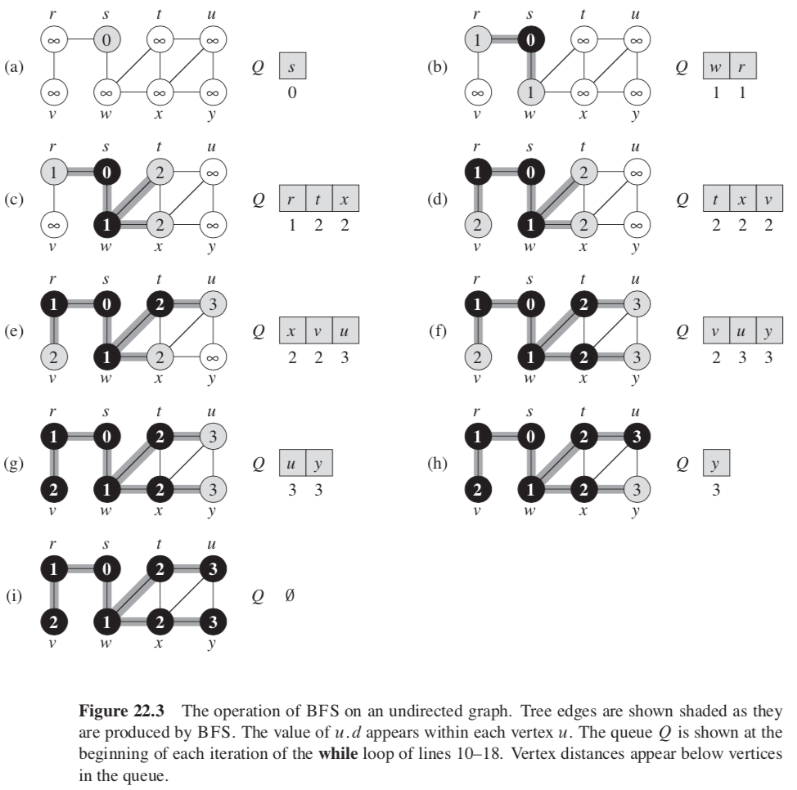
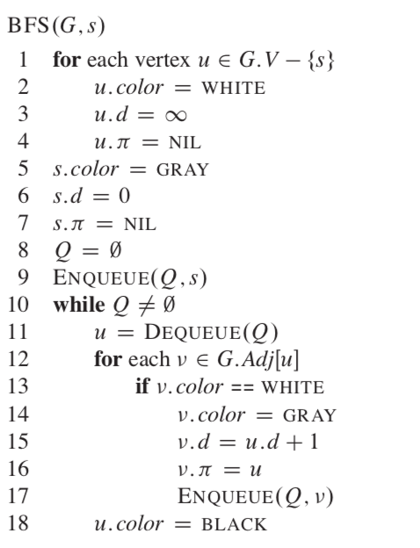
Breadth-first traversal

Slide 22
Breadth-first traversal

Slide 23
Breadth-first traversal
Enqueuing and dequeuing takes O(1), so the total time devoted to queue operations is O(V)
For finding adjacent elements, suppose we use adjacency list, the total time spent in scanning adjacency list is Θ(E)
Thus the total running time is O(V+E)
Thus breadth first search runs in time linear in the size of the adjacency list representation of G

Slide 24
Breadth-first traversal - simplified
–Choose any vertex, mark it as visited and push it onto queue
–While the queue is not empty:
Pop to top vertex v from the queue
For each vertex adjacent to v that has not been visited:
Mark it visited, and
Push it onto the queue
This continues until the queue is empty

Slide 25
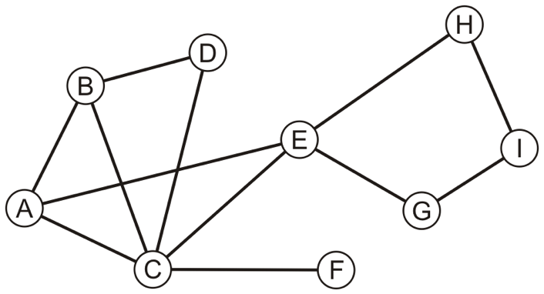
Breadth-first traversal: Example:

Slide 26
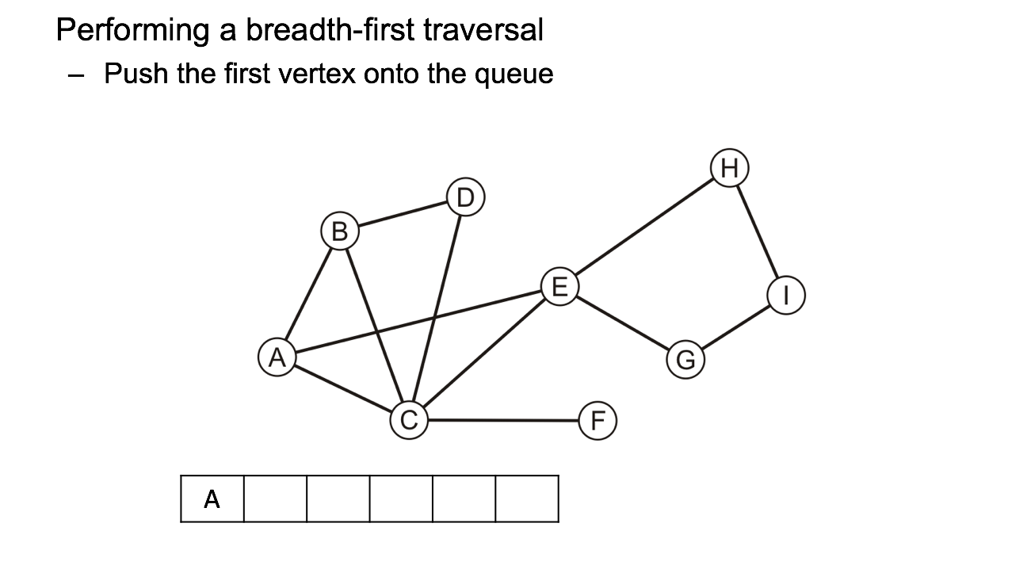
Breadth-first traversal: Example:

Slide 27
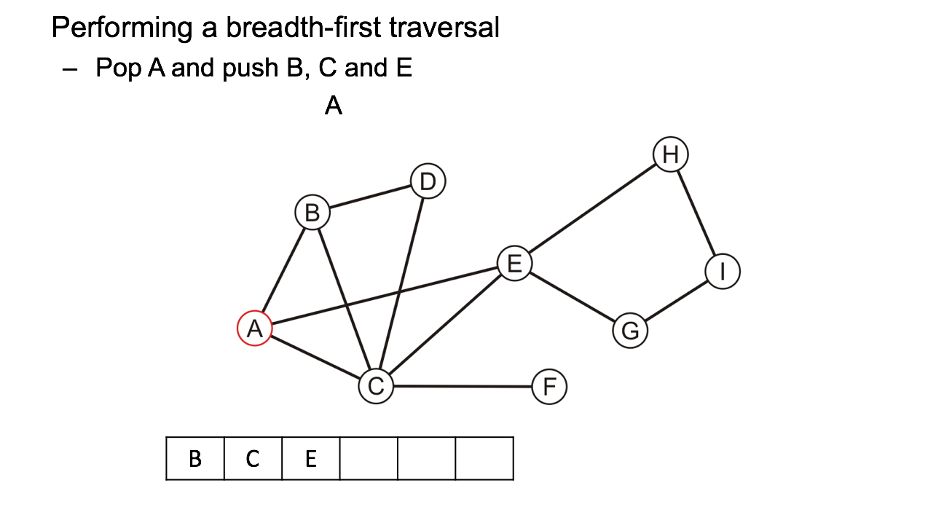
Breadth-first traversal: Example:

Slide 28
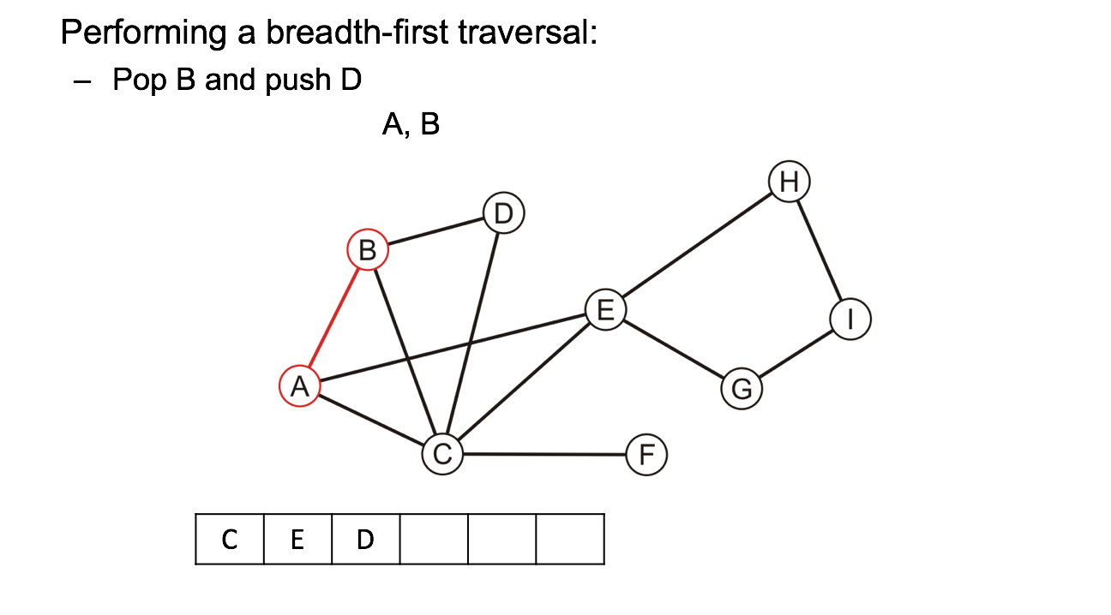
Breadth-first traversal: Example:

Slide 29
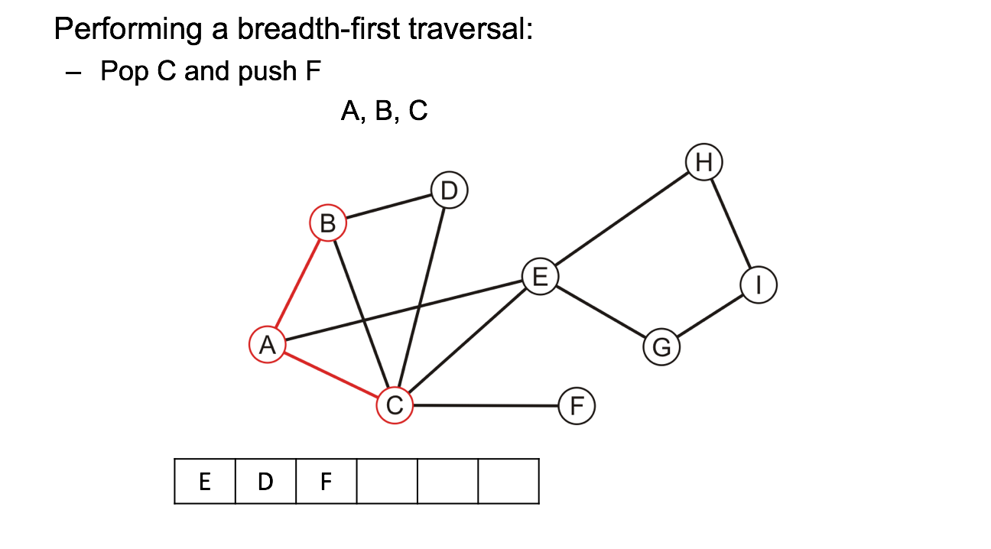
Breadth-first traversal: Example:

Slide 30

Breadth-first traversal: Example:

Slide 31

Breadth-first traversal: Example:

Slide 32

Breadth-first traversal: Example:

Slide 33
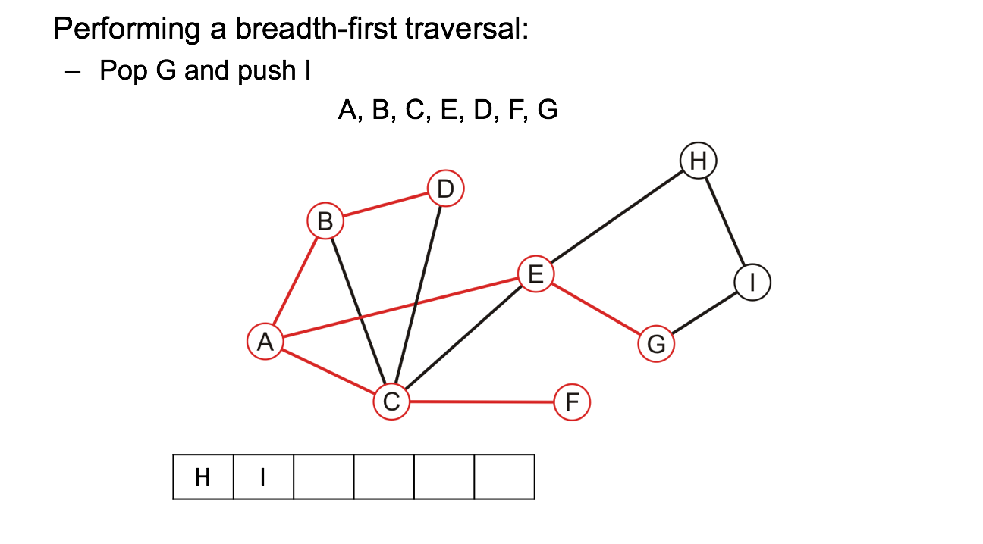
Breadth-first traversal: Example:

Slide 34

Breadth-first traversal: Example:

Slide 35
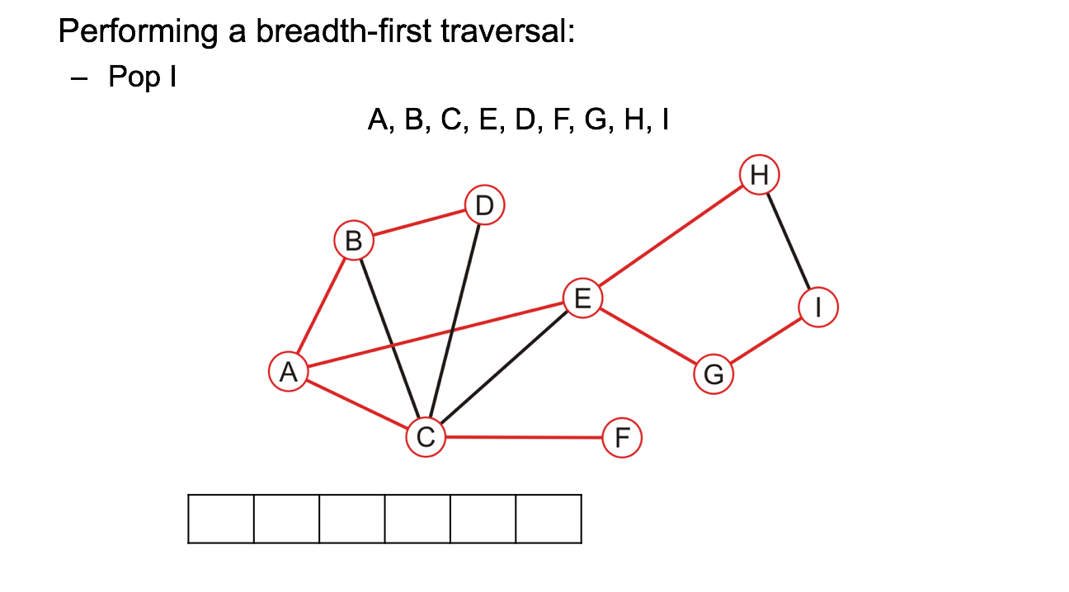
Breadth-first traversal: Example:

Slide 36

Breadth-first traversal: Example:

Slide 37
Depth-first traversal
Given a graph G = (V, E) and a source vertex s, a depth-first search (DFS) explores edges deeper whenever possible. Once a path has been fully explored, the search backtracks to explore other possible path
As in BFS, DFS colors vertices during the search. Each vertex is initially white, is grayed when it is discovered and is blackened when it is finished, that is, when the adjacency list has been examined completely
DFS also contains a timestamp - each vertex v has two timestamps: the first timestamp v.d records when v is first discovered (and grayed), and second v.f records when the search finishes examining v’s adjacency list (and blackens v)

Slide 38
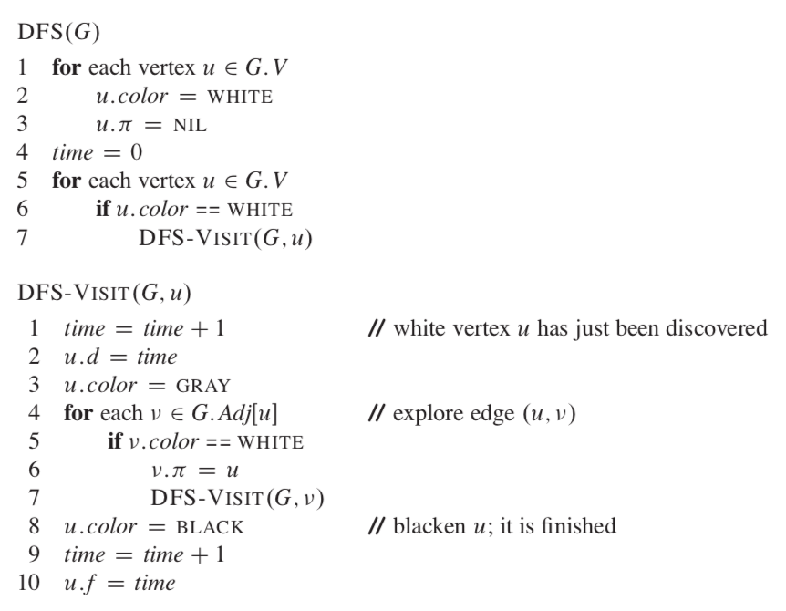
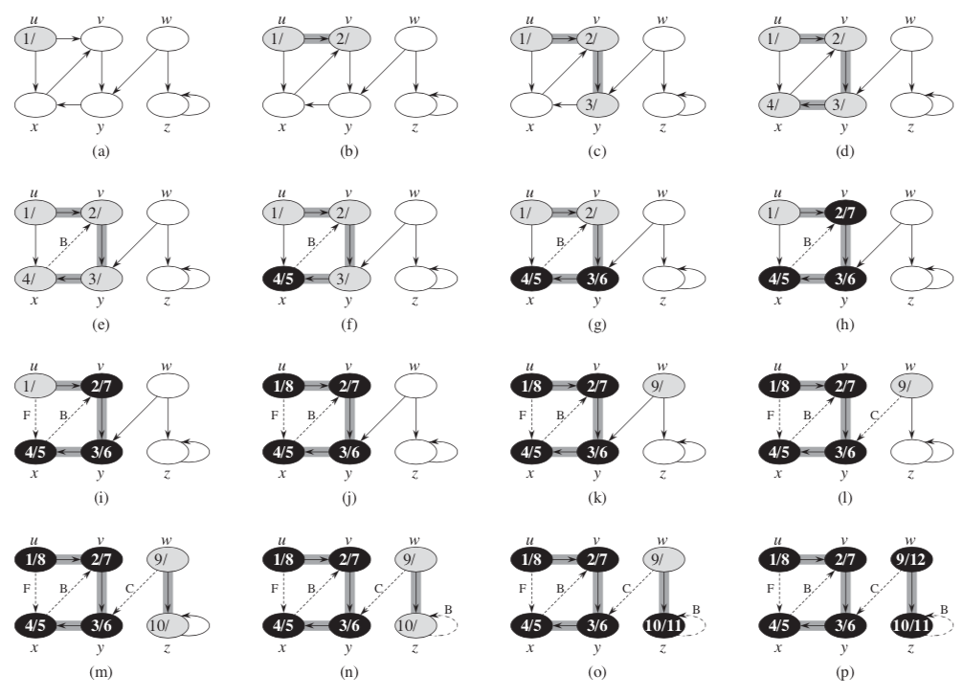
Depth-first traversal

Slide 39
Depth-first traversal
Lines 1 - 3 and lines 5-7 in DFS(G) take Θ(V)
DFS-VISIT is called exactly once for each vertex to all possible edges, thus
Thus the running time of lines 4-7 in DFS-VISIT takes Θ(E)
The running time of DFS is therefore Θ(V+E)

Slide 40
Depth-first traversal - simplified
–Choose any vertex, mark it as visited
–From that vertex:
If there is another adjacent vertex not yet visited, go to it
Otherwise, go back to the most previous vertex that has not yet had all of its adjacent vertices visited and continue from there
–Continue until no visited vertices have unvisited adjacent vertices

Slide 41
Depth-first traversal: Example

Slide 42

Depth-first traversal: Example

Slide 43

Depth-first traversal: Example

Slide 44

Depth-first traversal: Example

Slide 45

Depth-first traversal: Example

Slide 46

Depth-first traversal: Example

Slide 47

Depth-first traversal: Example

Slide 48

Depth-first traversal: Example

Slide 49

Depth-first traversal: Example

Slide 50
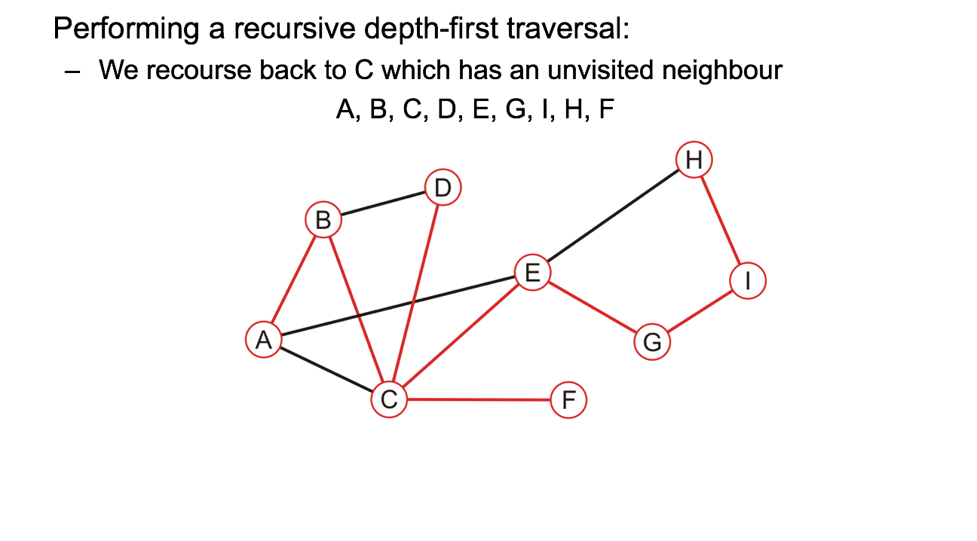
Depth-first traversal: Example

Slide 51
Depth-first traversal: Example

Slide 52
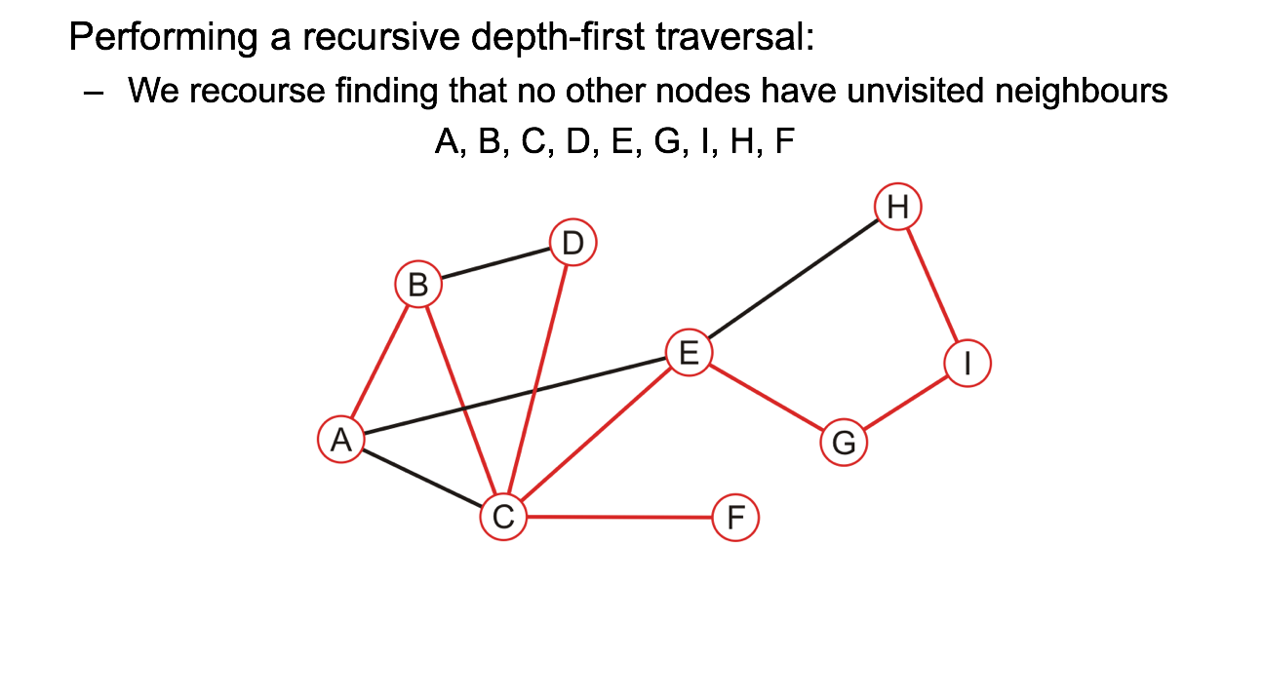
Depth-first traversal: Example

Slide 53
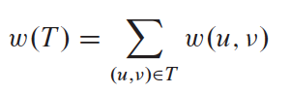
Minimum Spanning Tree Problem
Given a set of servers, how to connect all servers using minimum amount of cables?
Given a set of pins, how to connect all pins using minimum amount of wires?
We can model minimum spanning tree problem with a connected, undirected graph G = (V, E) which the goal is to find an acyclic subset T ⊆ E that connects all vertices and whose total weight is minimized

Slide 54
Minimum Spanning Tree Problem
The weight of a minimum spanning tree is the sum of the weights on all the edges which comprise the spanning tree
The weight of this minimum spanning tree is 15

Slide 55
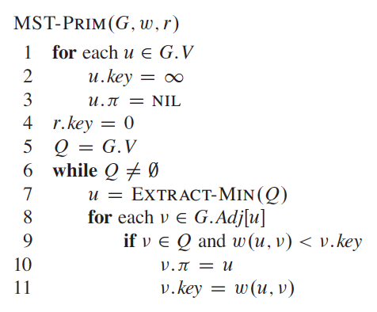
Prim
Prim’s algorithm is also greedy algorithm because at each step, it extracts the minimum edges that adds to the tree
r -> root of the minimum spanning tree
u.𝜋 -> predecessor
All vertices that are not in the MST is in the min-priority queue Q, represent by the key attribute
LIne 1 -3: Set all key to inf, meaning no edges is connected to each u
LIne 5: puts all V into the priority queue Q
Line 7: take out the minimum edges from the Q (it will start at root because it has value 0)
Line 8-9 takes all adjacent edges with u, if they are still at the queue and and if the current key is bigger than the w(u,v), called decrease-key

Slide 56
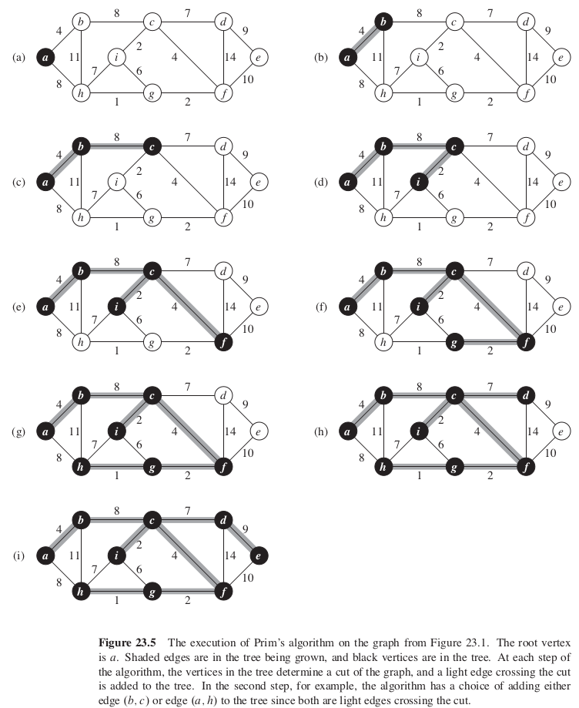
Prim

Slide 58
Prim - Running Time
Depends on how we implement the priority queue Q
If we use binary min-heap,
Line 1-5 takes O(V) time for BUILD-MIN-HEAP
Line 6 runs |V| times, while EXTRACT-MIN takes O(lg V), thus the total time for all calls to EXTRACT-MIN is O(V lg V)
Line 8 for loop runs O(E) while Line 11 is a DECREASE-KEY operation which takes O(lg V) thus the total time for all calls to DECREASE-KEY is O(E lg V)
Thus O(V lg V) + O(E lg V) = O(E log V) since we assume that graph G is connected and thus |E| is at least |V|-1

Slide 59
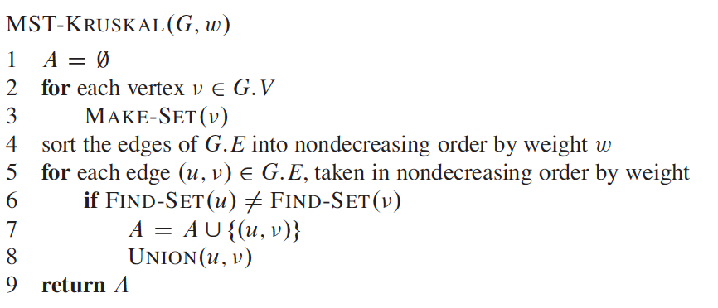
Kruskal
Kruskal is a greedy algorithm because at each step, it adds to the forest an edge of least possible weight
Line 1: Initialize A as a holder for keeping the MST
Line 2-3: Create V amount of trees, each containing only one vertex
Line 4: Sort all edges from lowest to highest
Line 5: FIND-SET returns element from the set that contains u. If FIND-SET(u) not equal to FIND-SET(v), i.e., there is no cycle happening, add the edge (u, v) to A. Then combine set u and set v together to a tree by calling UNION

Slide 60
Kruskal
Sort all the edges
Pick the smallest, and repeat
If you pick and it causes a cycle, don’t pick…
Finish!

Slide 61
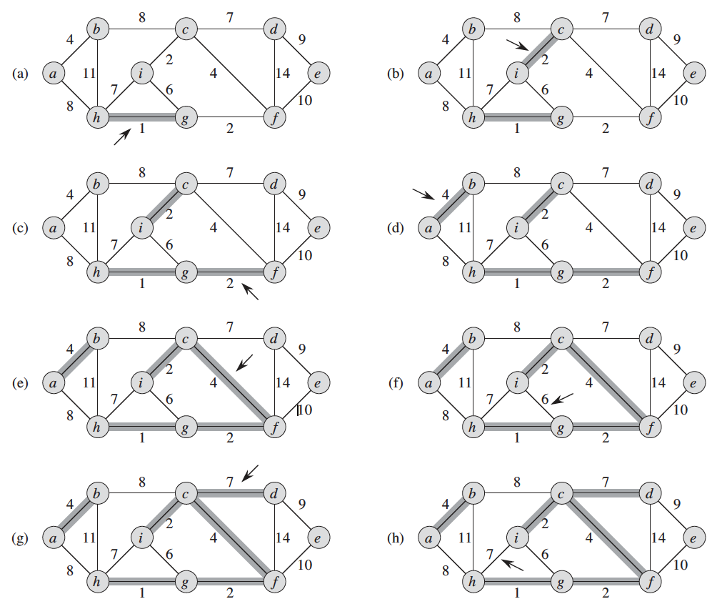
Kruskal

Slide 62
Kruskal - Running Time
You first have to sort the edges which is O(E lg E) (remember sorting algorithms?)
Then you have to check whether each one is making a cycle which takes a complexity of O(E).
Thus O(E lg E) + O(E) = O(E lg E)

